Slide 1

Renewable Energy Forecasting
Jocelyn Zhao, Cecilia Dong, Charlene Wei

Slide 2
Agenda
01
02
03
04
05
Project
Objective
Data Preparation
Exploratory Analysis
Models Processing
Final Model
&
Forecast

Slide 3

Project Objective
02
Background Information
01
As wind farms becomes more prevalent, the wind power forecasting become more crucial
Company Needs
02
01
The utility firms need precise estimates of the electricity generated by wind turbines to meet demand
03
Goal
03
Create a daily forecast for Active Power Generation for the turbine for the next 5 day period

Slide 4
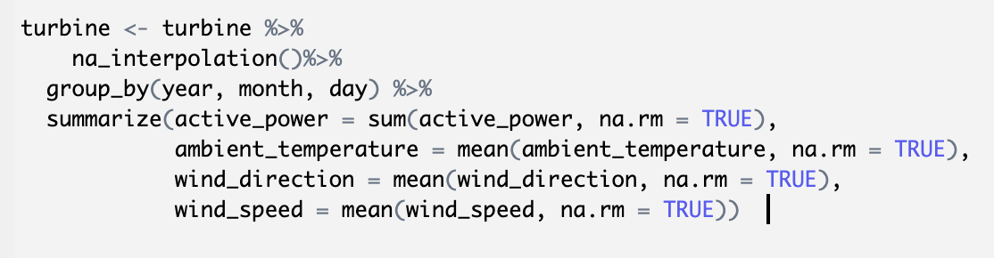
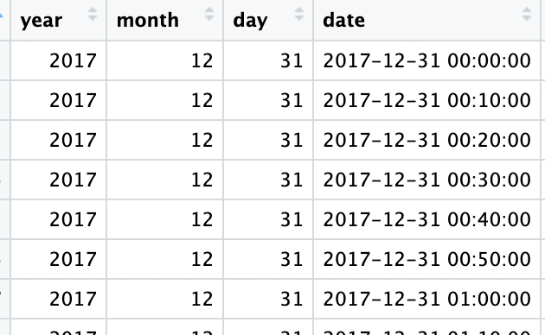
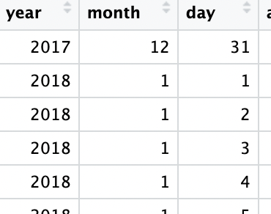
Data Preparation - changing time index

Slide 5
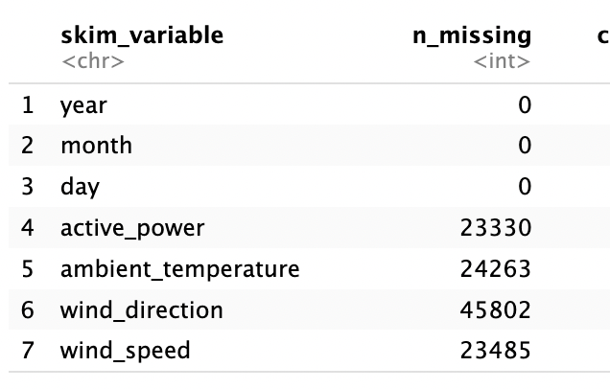
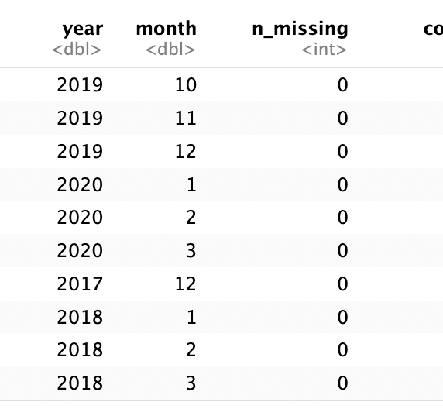
Data Preparation - missing value

Slide 6
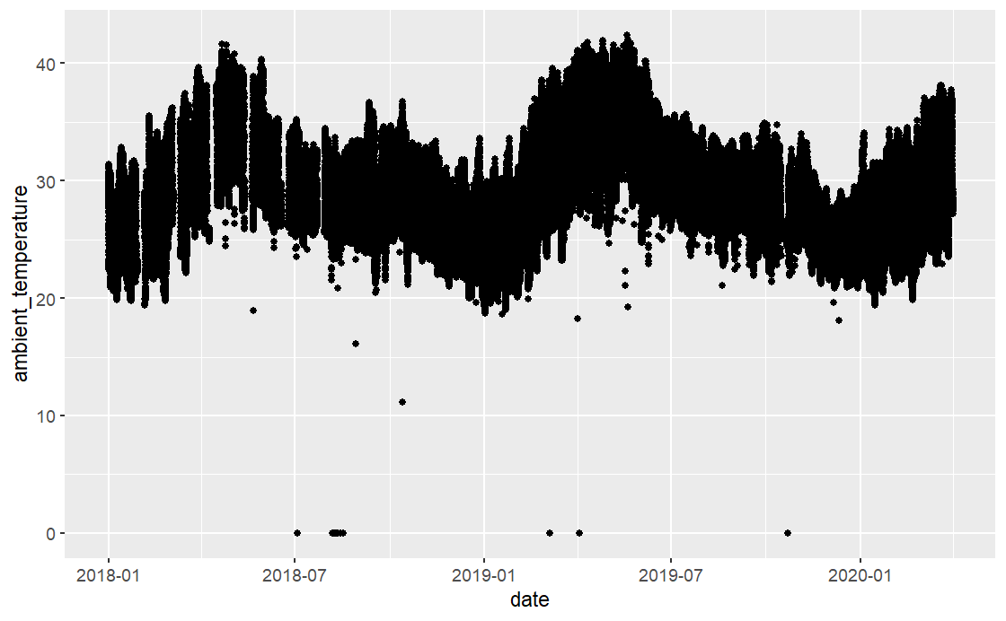
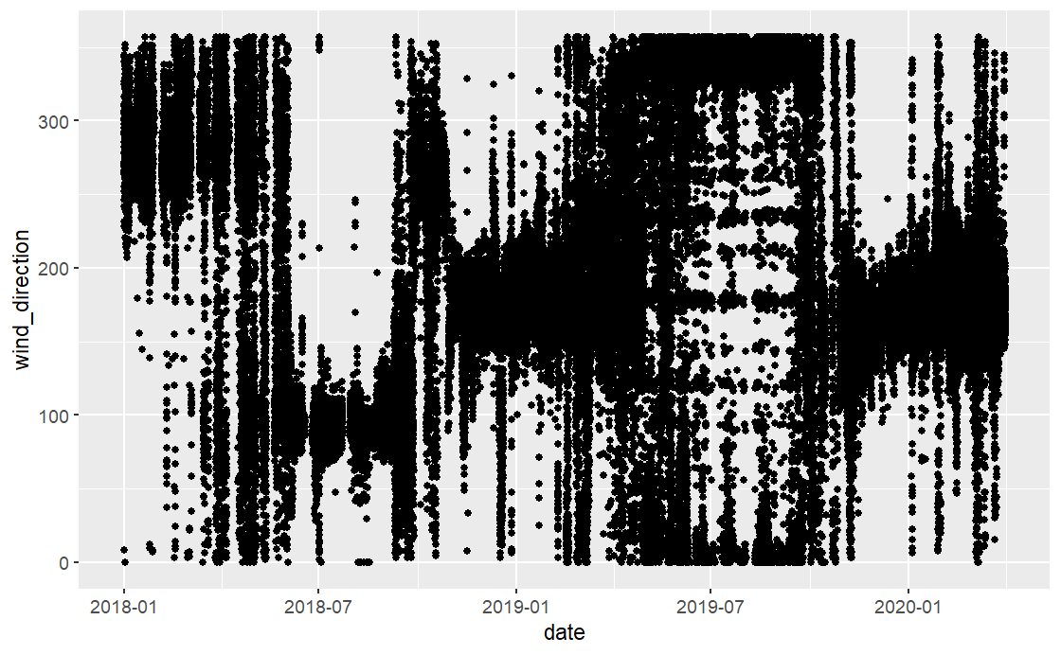
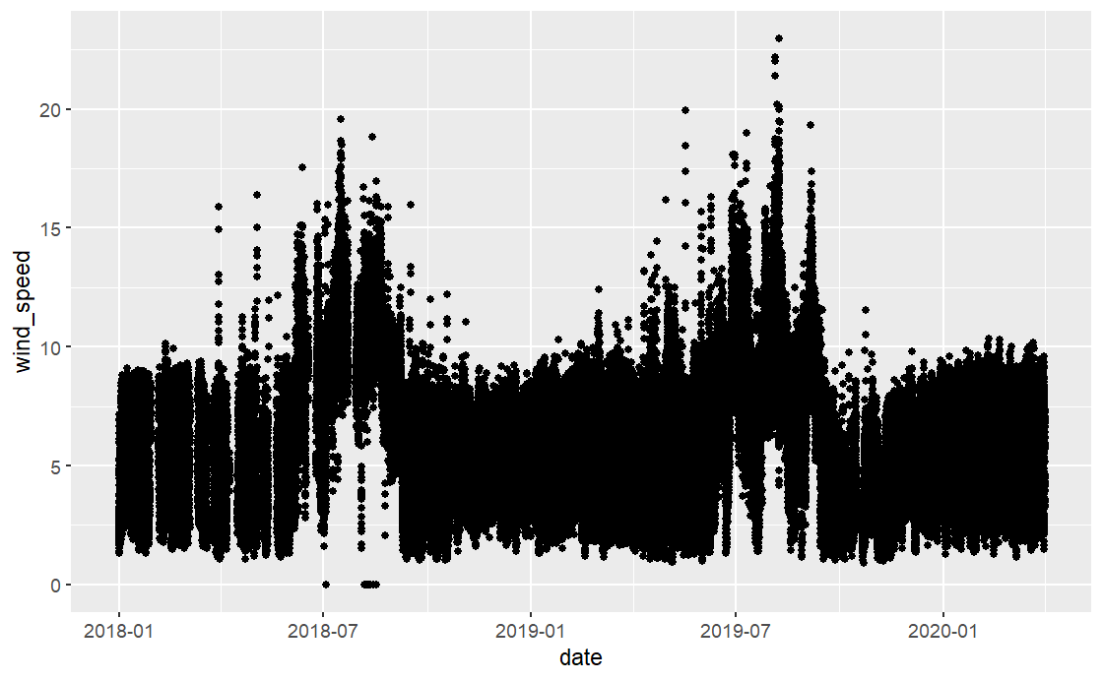
Exploratory Analysis - explanatory variables
Ambient Temperature
Wild Direction
Wind Speed
Plotting variables with time
No Event Variables

Slide 7
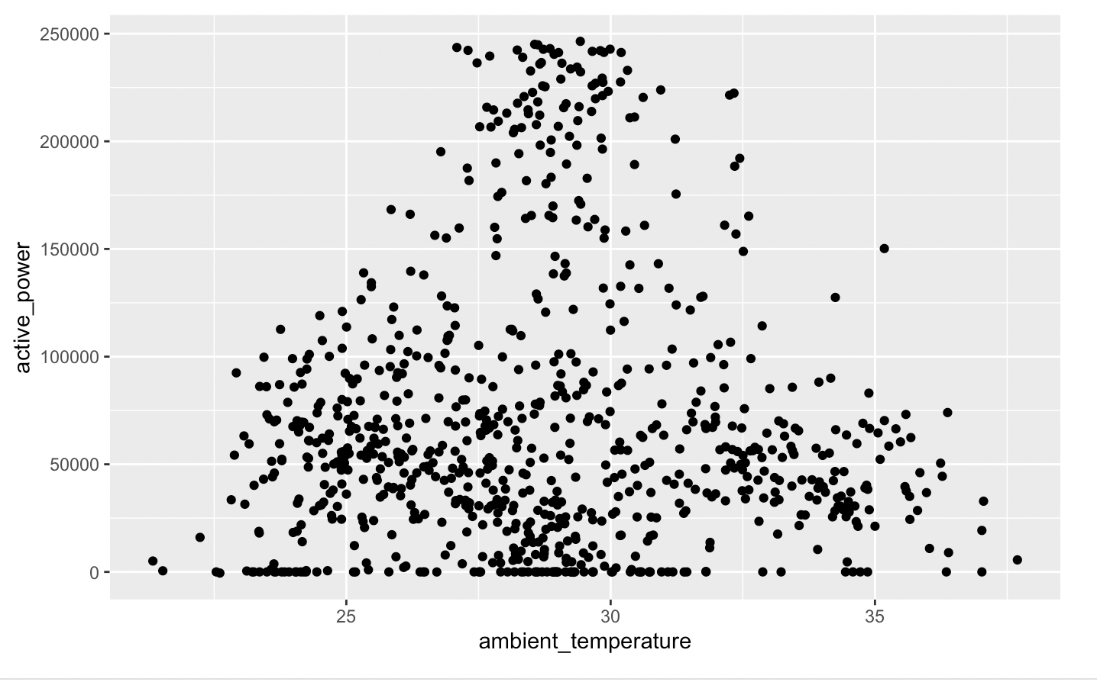
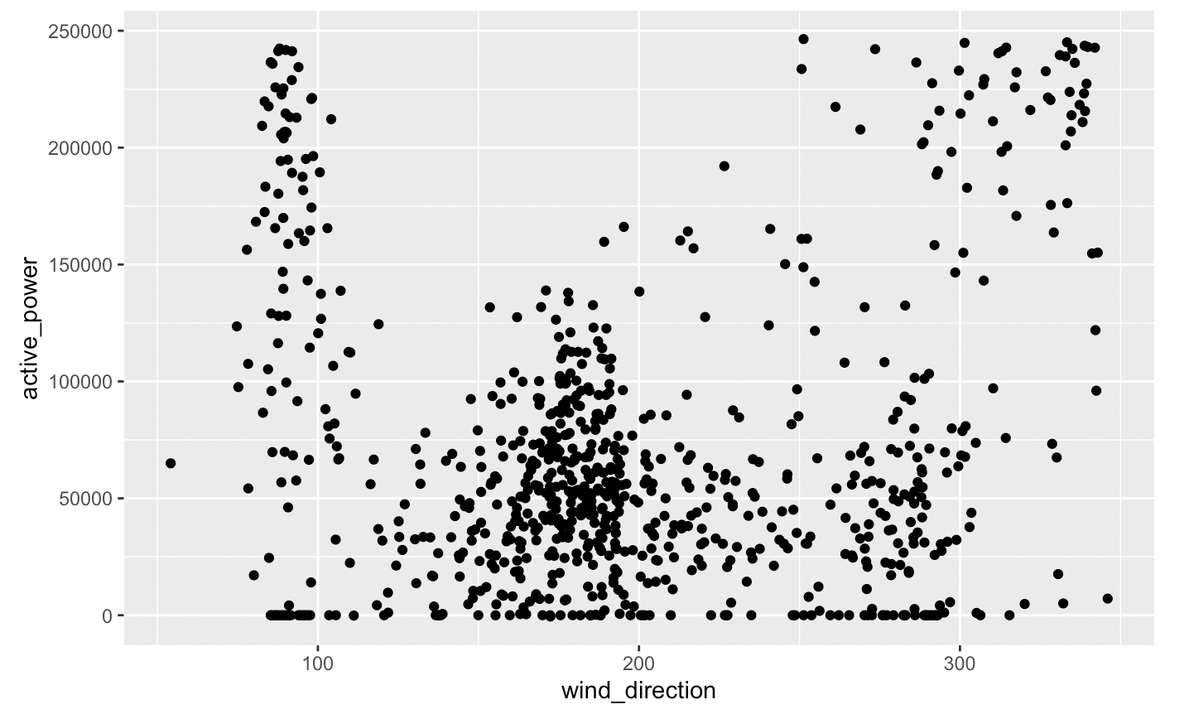
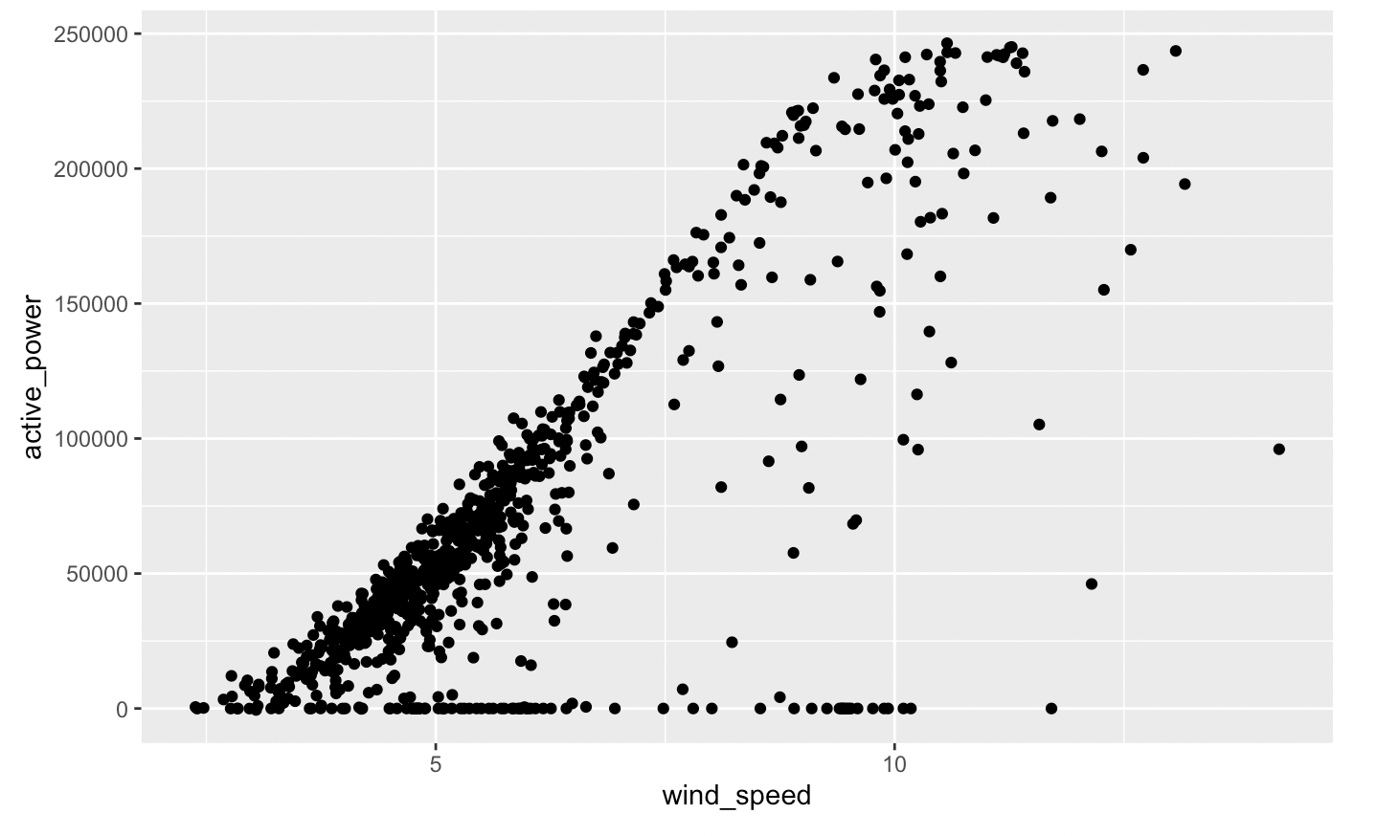
Exploratory Analysis - explanatory variables
Ambient Temperature
Wild Direction
Wind Speed
Plotting variables with response variable
There is correlation between wind speed and active power

Slide 8
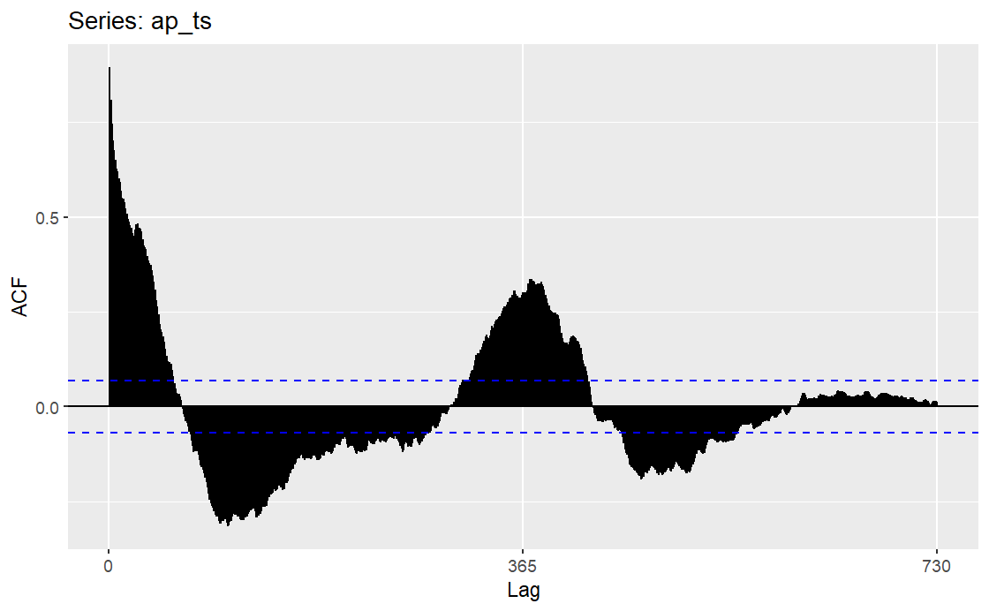
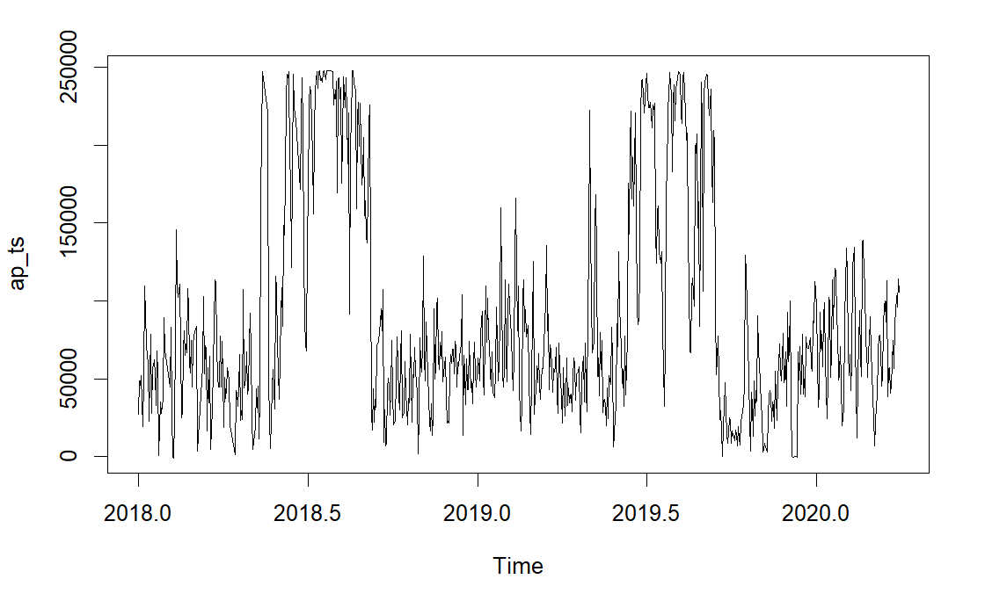
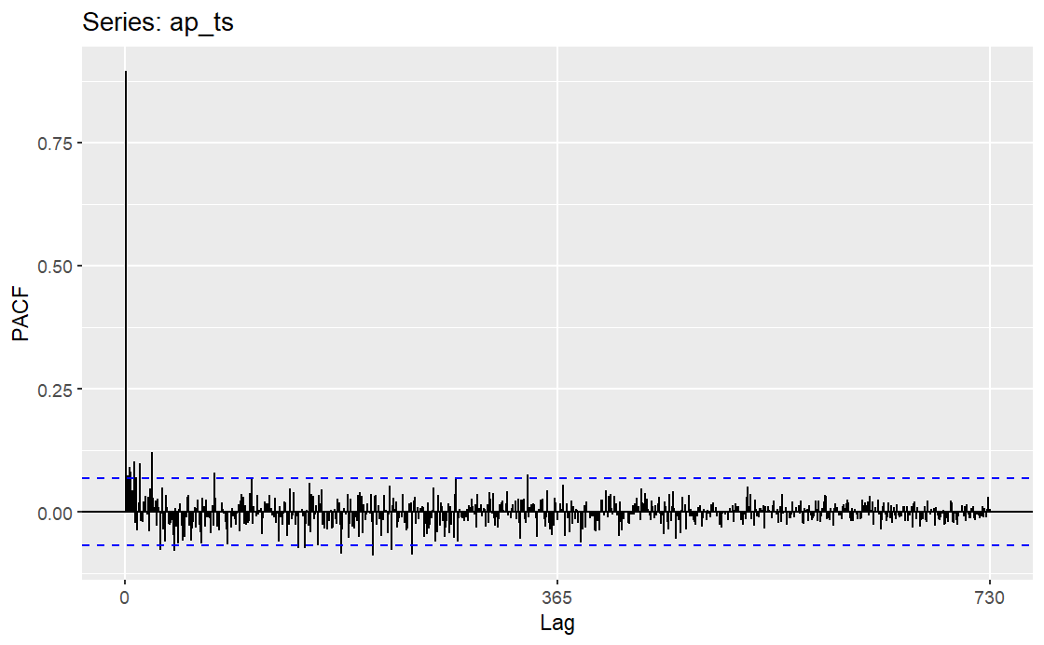
Exploratory Analysis - time series
Time series: values around May each year are higher than other values
ACF: decays
PACF: cut off quickly

Slide 9
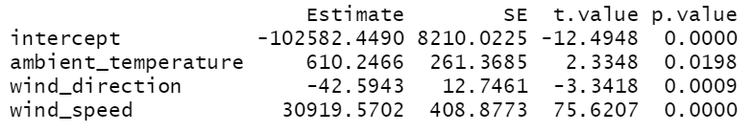
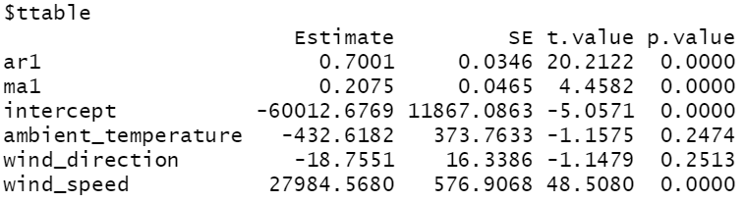
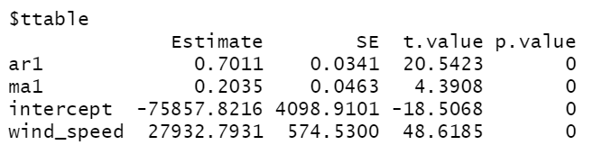
Models Processing
Exploring linear regression first
(all variables are significant at significance level 0.05)
Auto.arima > arima(1,0,1)
RMSE: 16046.99
Test for white noise (p-value = 8.019e-06)
Two variables are insignificant
arima(1,0,1) deleting two insignificant variables
RMSE: 16073.93
Test for white noise (p-value = 6.078e-06)
All variables are significant

Slide 10
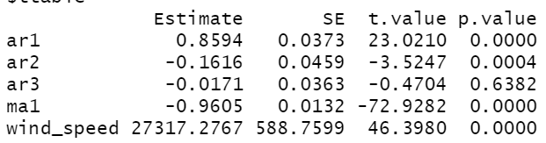
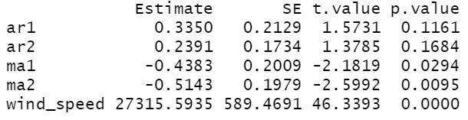
Models Processing
4. arima(1,1,1) < plot shows not stationary
RMSE: 17095.26
Test for white noise (p-value = 6.078e-06)
All variables are significant
5. arima(2,1,1) Final model
RMSE: 16052.45
Test for white noise (p-value = 0.0003047)
All variables are significant
6. arima(3,1,1)
RMSE: 16050.29
Test for white noise (p-value = 0.0002662)
Ar3 is not significant
7. arima(2,1,2)
RMSE: 16059.29
Test for white noise (p-value = 0.001501)
Ar1 & ar2 is not significant

Slide 11
Model Comparison
Model | RMSE | MAE | Issue involved
Auto.Arima(1,0,1) + temp + direction + speed | 16046.99 | 10326.17 | Residuals are not white noise; temperature and direction are not significant
Arima(1,0,1) + speed | 16073.93 | 10296.59 | Residuals are not white noise; relatively high forecast error
Arima(1,1,1) + speed | 17095.26 | 11094.76 | Residuals are not white noise; high forecast error
Arima(3,1,1) + speed | 16050.29 | 10314.68 | Residuals are not white noise; ar3 is not significant
Arima(2,1,2) + speed | 16059.29 | 10298.89 | Residuals are not white noise; ar1 and ar2 are not significant
Arima(2,1,1) + speed | 16052.45 | 10319.95 | Residuals are not white noise
(1)
(2)
(3)
(4)
(5)
(6)
Notes:
We have tried 6 models. They have a common defect of residuals are not white noise. For model 1, 4 and 5, we find some of terms in the model insignificant. For model 2 and 3, they have a relatively high forecast error of RMSE and MAE compared to the others. Thus, we decide to choose the mode 6 arima with a p,d,q of 2, 1, 1 and the intervention variable wind speed as our optimal model.

Slide 12
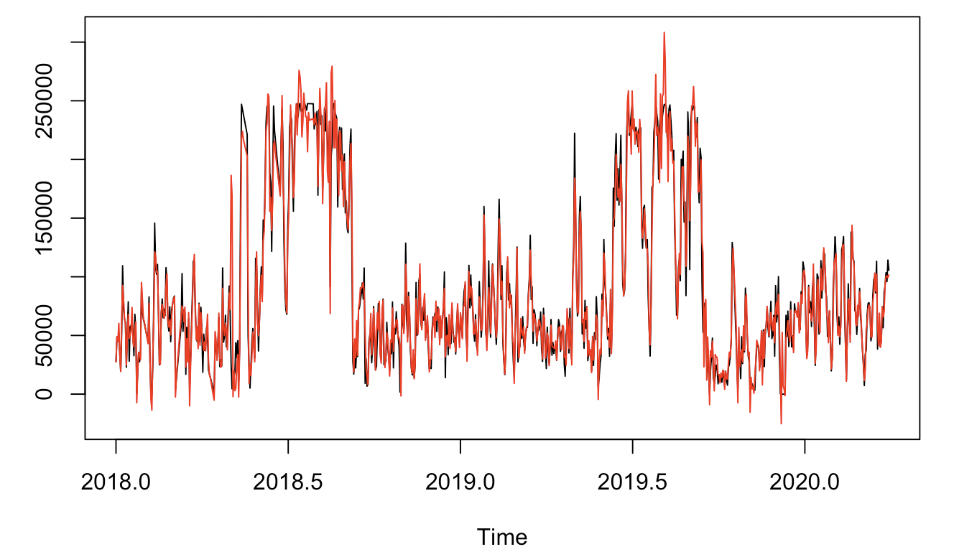
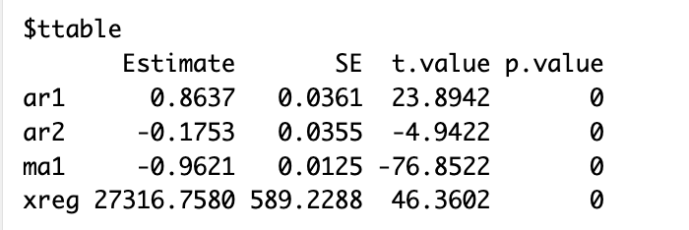
Final Model - Arima (2, 1, 1) + Speed
All the terms are significant, and the generated forecast fits well with the actual data line.
Notes:
We use sarima to look at the significant level of each term. The result is shown on the left. All the two autoregressive terms, one moving average term and the intervention term wind_speed are significant. And looking the overlap plot shown on the right, red line represents the generated forecast, and the black line represents the actual data line. The forecasts capture well of the peak and valley of the actual data.

Slide 13
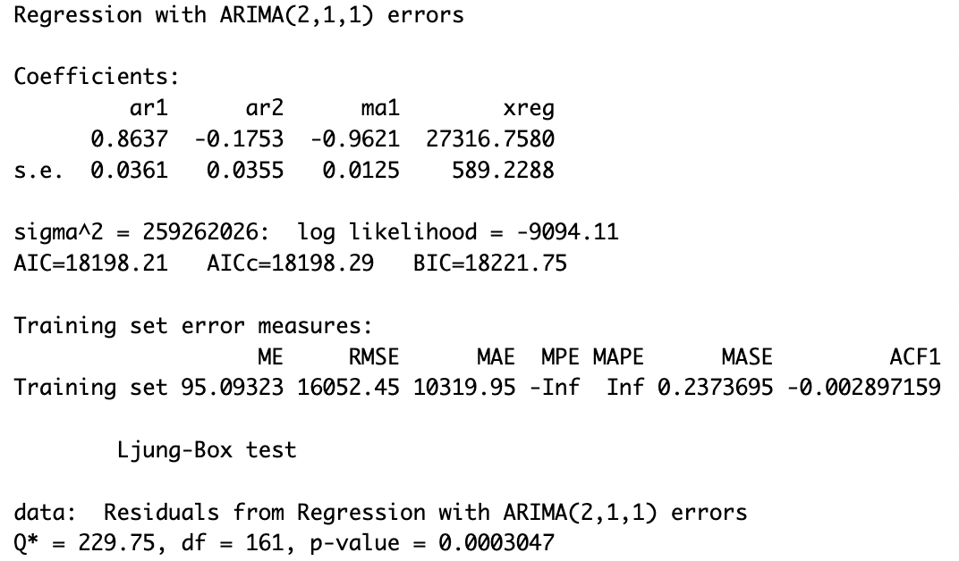
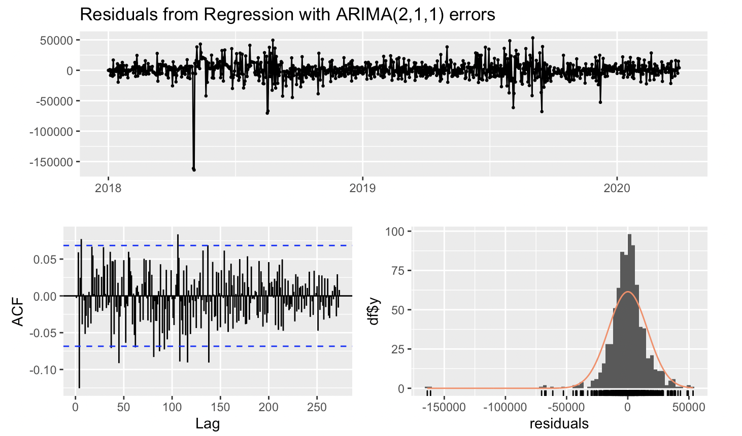
Final Model - Arima (2, 1, 1) + Speed
The forecast error is within an acceptable range, but the residuals are not white noise.
Notes:
The RMSE is 16052.45, and the MAE is 10319.95, this forecast error performs decent among the other models we have tried. Shown below, the null hypothesis of the Ljung-box test is the residuals are white noise, the alternative hypothesis is the residuals are not while noise. The resulted p-value is less than 0.05, we reject the null, the residual are not white noise. This is a drawback of our final model.

Slide 14
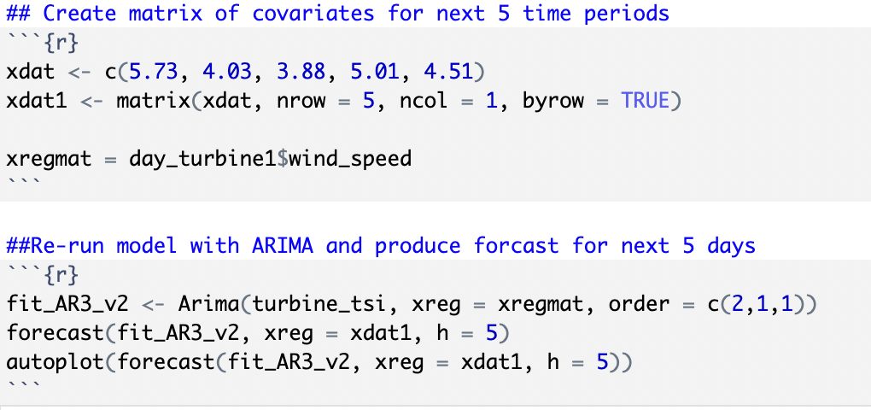
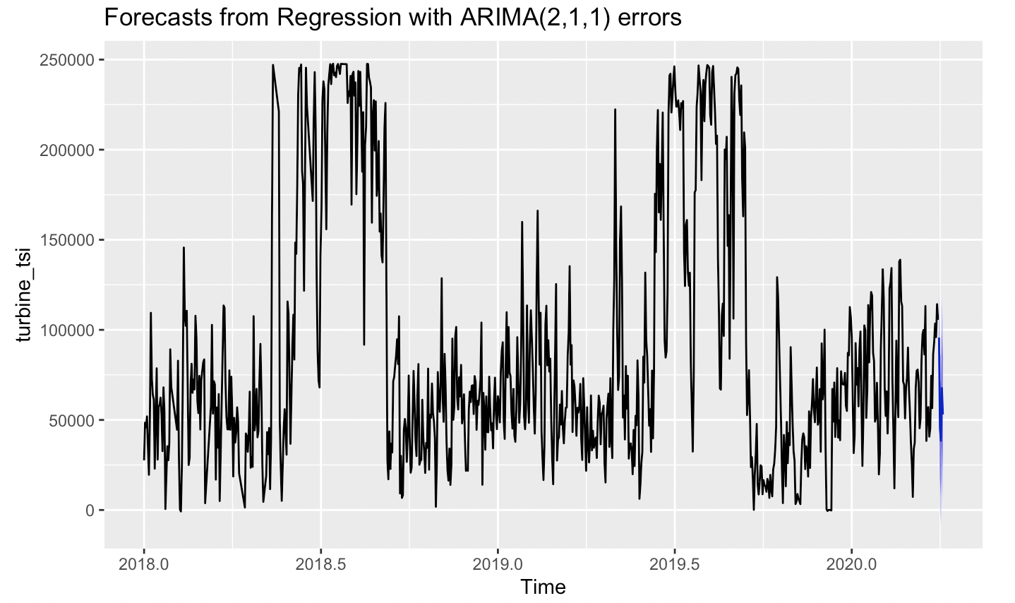
Forecast Result - Arima (2, 1, 1) + Speed
The daily forecast for Active Power generation for turbine for the next 5 day period
Date | Forecast(kW)
3/31/2020 | 95691.92
4/01/2020 | 45254.71
4/02/2020 | 38432.54
4/03/2020 | 67648.10
4/04/2020 | 53040.16
Notes:
Shown on the right hand side graph, through create matrix of covariates for the actual wind speed data of the next 5 period, and re-run the model with arima, we generate the daily forecast for active power generation for turbine between March 31 2020 to April 4 2020. The forecast error is tested to be within a reasonable range.

Slide 15
Thank you!

